Slide 1

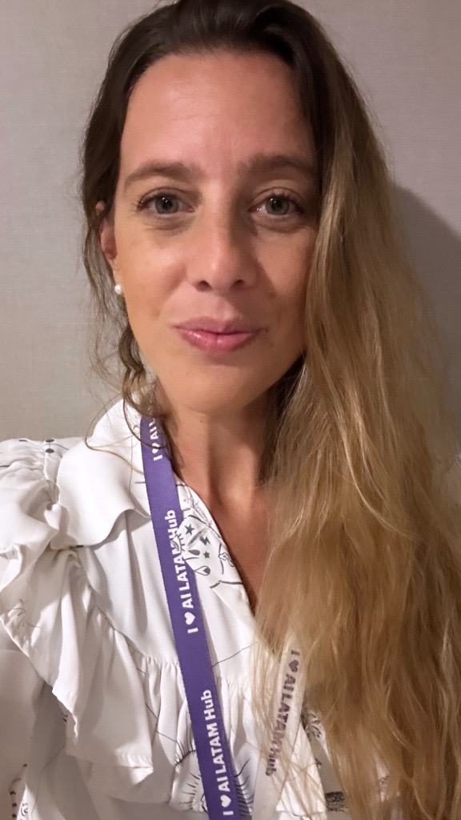
María Paz Gelpi
SELECTED EXPERIENCE
RAI Team Lead (2025- Today)
Leads the Responsible AI team within Data Governance structure at Accenture
Designed end-to-end RAI framework: RAI Intake Assessment, RAI Architecture Patterns, and RAI Scorecard.
AI Product Owner /Tech Lead (03 2023– Today​)
Leads cross functional GenAI and ML teams and Translates business requirements into technical specifications and actionable roadmaps for the team.
Supports architecture design for agentic AI systems
Product lifecycle ownership: roadmap prioritization, QA framework definition, OKR design, risk management, and continuous improvement cycles
PROJECTS:
AskAmethyst / 360VN : Snowflake Cortex conversational agent for Finance & Sales: Tech Product Owner and tech lead
Gemini Enterprise POC : Platform evaluation for Competitive Intelligence: Tech Lead for POC, architecture definition and use case scoping.
AskAxiom / GenNav : Conversational RAG platform for Finance: end-to-end Product ownership
Data Scientist R&I (09 2021– 03 2023 )​
OptForce Model - Data Scientist (Demand Forecasts improvement, Metrics design )
OptForce Model : Business Analyst (Design Thinking Facilitator, OKR Design)
Demand Prediction Model ( XGBoost , Random Forest, Kmeans; LGBM )
Data Scientist - Marketing Analytics Team (08 2019 – 08 2021)
Topic Model (Gensim, BERT, Spacy)
Bot Detection Model (K-means, XGBoost)
GCP Data Science Platform Migration
Continuous improvement Lead- CIS Ingeniería (12 2014 – 06 2018)​
Quality Management Lead – Gihon Laboratorios (01 2012 – 11 2014)​
Planning – Nutreco Alimentos (11 -2010- 08-2011)
AI LLM Technology Architecture Associate Manager
Technology - Data & AI
maria.paz.gelpi@accenture.com
Mar del Plata, Argentina
PROFESSIONAL BACKGROUND
AREA OF EXPERTISE
Chemical Engineer , Data Scientist and AI Product Owner
Tech Lead and PO on GenAI & ML products
MBA in Technology
Responsible AI Lead : Data Governance structure
HARD/SOFT SKILLS & TOOLS
Generative AI & LLMs: Agentic AI Systems, RAG, Prompt Engineering, QA Metrics design, vertex ai, Gemini Enterprise, Snowflake Cortex
ML & Data Science: XGBoost, Prophet, LGBM, Random Forest, NLP (BERT, Spacy, Gensim), TensorFlow, Keras
Cloud & Data Platforms: GCP (BigQuery, Vertex AI), Snowflake, Azure (Azure DevOps)
Dev: Python, SQL
Product & Delivery: Product Ownership, Roadmap Strategy, QA Frameworks, Agile / Scrum, Risk Assessment, KPI Design
AI Governance & RAI: Responsible AI Frameworks, RAI Architecture Patterns, AI Risk Assessment, AI Governance.
EDUCATION
Chemical engineering – Universidad Nacional de Mar del Plata – 2011
MBA in Technology – UdeSA (2024-2025)
Postgraduate in Continuous Improvement – Universidad general Sarmiento - 2016
LANGUAGES
English (C1)
Spanish (Native)
INDUSTRY
IT
Oil & Gas
Supply Chain
Pharma
Finance
HR
Accenture Applied Intelligence

